Slide 1

Introduction to NLP
What is NLP ?

Slide 2

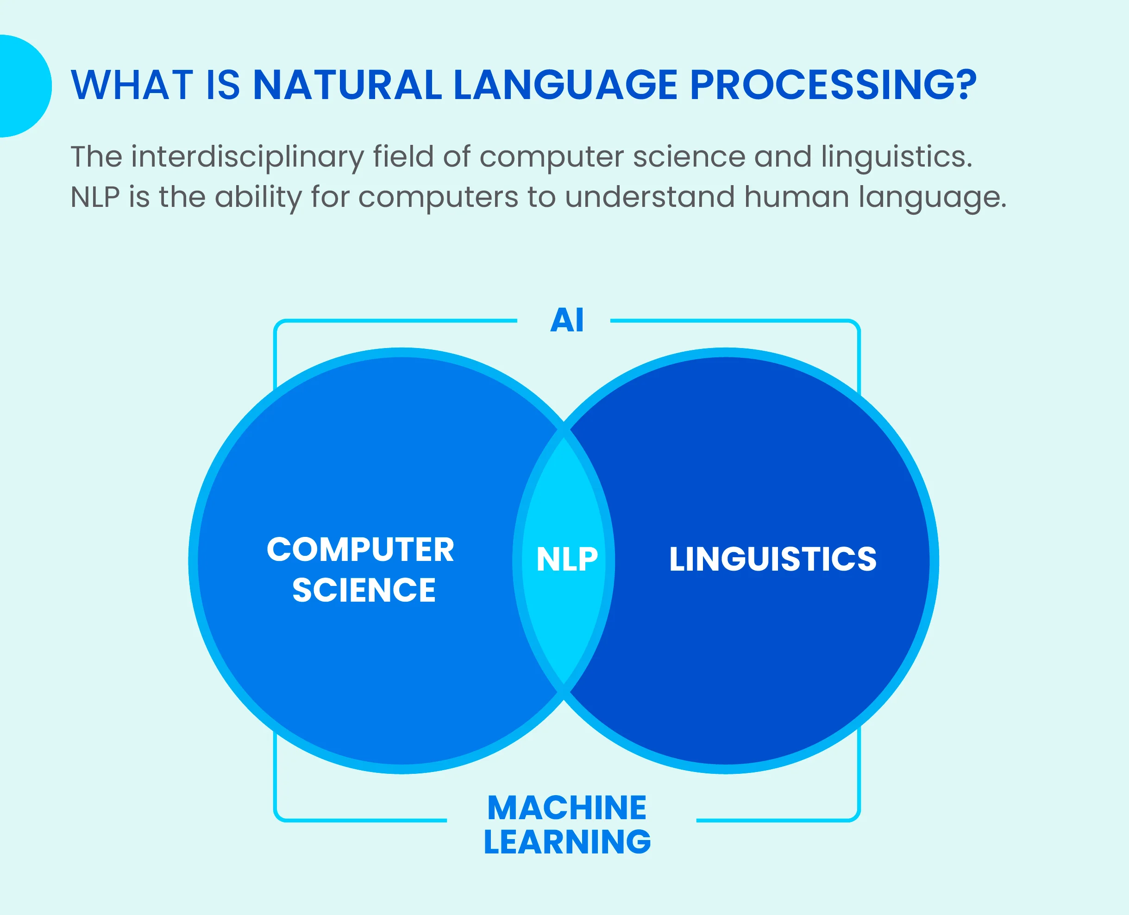



Introduction
ARTIFICIAL INTELLIGENCE
Linguistics
MACHINE LEARNING
Computer Science
DEEP LEARNING
CV NLP
Artificial intelligence

Slide 3

Introduction
ARTIFICIAL INTELLIGENCE
MACHINE LEARNING
It enables computers to understand, interpret and respond to human languages or text data.
DEEP LEARNING
CV NLP

Slide 4
Categories of NLP
Deep Learning Applications
Natural Language Understanding (NLU)
Natural Language Generation (NLG)

Slide 5

1. Natural Language Understanding (NLU)
1. Basic Understanding of Sentences: NLU algorithms read and analyze text to understand what a sentence means, such as identifying the main idea or intent behind it.
2. Complex Understanding of Conversations: These algorithms can also interpret more complicated text, like figuring out the meaning and context in a dialogue between two people.

Slide 6


1. Natural Language Generation (NLG)
Ability of a machine to generate unique human-like text or speech.
For example :
chatbots

Slide 7

Applications of NLP
NLP
Text based generative AI tools
Search Engines
Virtual Assistants
Translation Services
Sentiment Analysis
Email Filters
Content Recommendation
Resume Screening
Content Summarization

Slide 8

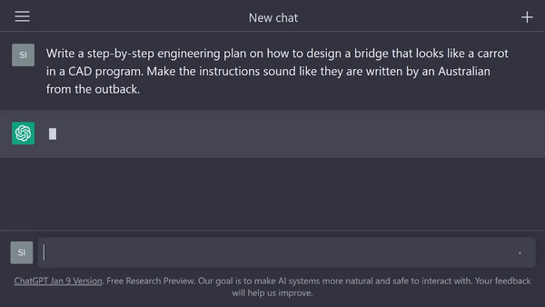
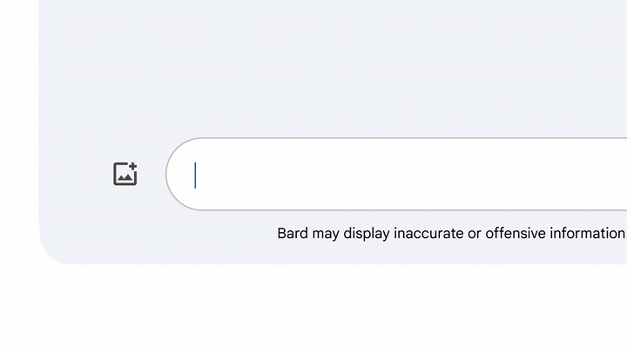
1. Text Based Generative AI tools
NLP
ChatGPT
Google BARD
Text based Gen AI tools
Search Engines
Virtual Assistants
Translation Services
Sentiment Analysis
Email Filters
Content Recommendation
Resume Screening
Content Summarization

Slide 9
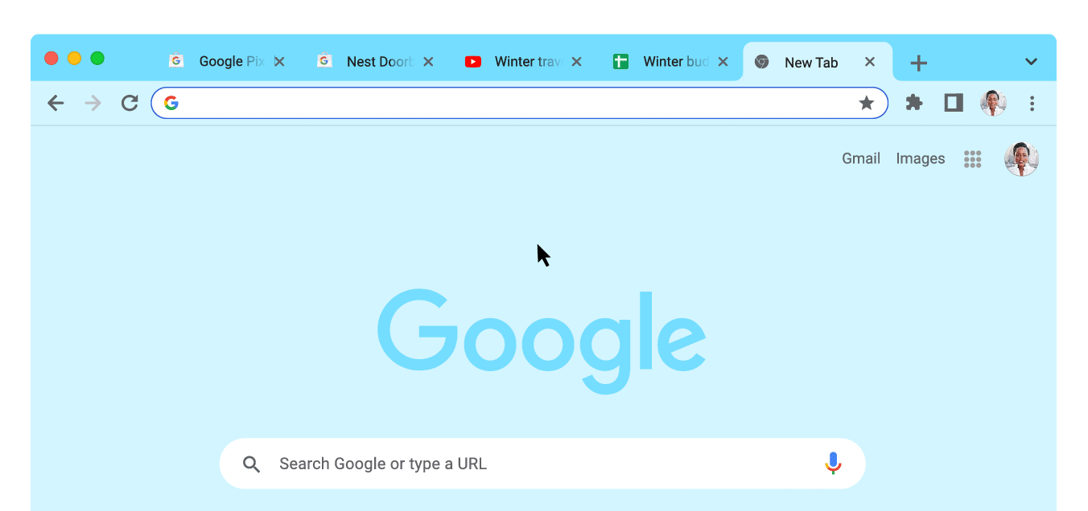
2. Search Engines
NLP
Google Chrome
Text based Gen AI tools
Search Engines
Virtual Assistants
Translation Services
Sentiment Analysis
Email Filters
Content Recommendation
Resume Screening
Content Summarization

Slide 10

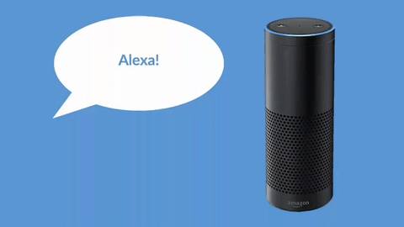
3. Virtual Assistants
NLP
Google Assistants
Virtual Assistants
Text based Gen AI tools
Search Engines
Virtual Assistants
Translation Services
Sentiment Analysis
Email Filters
Content Recommendation
Resume Screening
Content Summarization

Slide 11
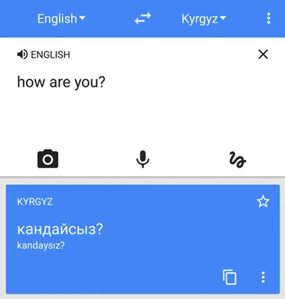
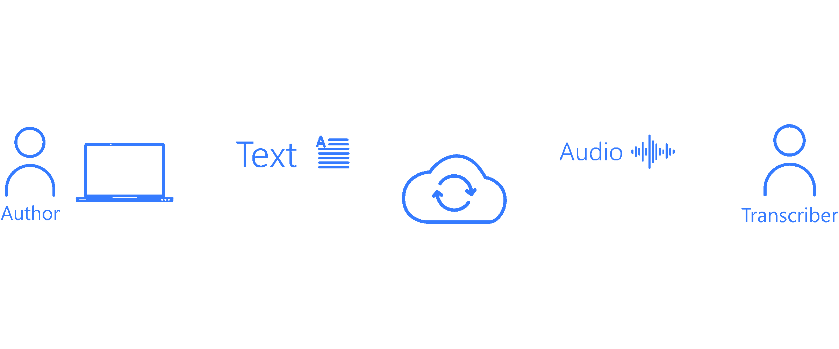
4. Translation Services
NLP
Google Translate
Text to Speech
Text based generative AI tools
Search Engines
Virtual Assistants
Translation Services
Sentiment Analysis
Email Filters
Content Recommendation
Resume Screening
Content Summarization

Slide 12


5. Sentiment Analysis
NLP
Customer Feedback
Social Media Conversation
Text based generative AI tools
Search Engines
Virtual Assistants
Translation Services
Sentiment Analysis
Email Filters
Content Recommendation
Resume Screening
Content Summarization

Slide 13
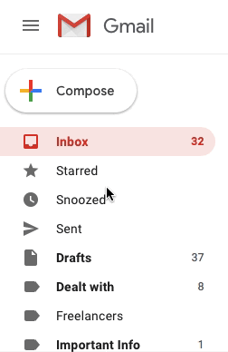
6. Email Filters
Spam email
NLP
Text based generative AI tools
Search Engines
Virtual Assistants
Translation Services
Sentiment Analysis
Email Filters
Content Recommendation
Resume Screening
Content Summarization

Slide 14
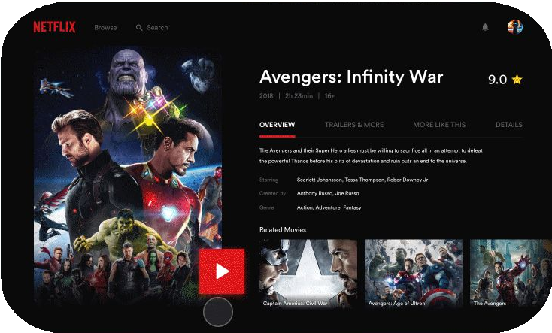
7. Content Recommendation
NLP
Netflix
Text based generative AI tools
Search Engines
Virtual Assistants
Translation Services
Sentiment Analysis
Email Filters
Content Recommendation
Resume Screening
Content Categorizations

Slide 15
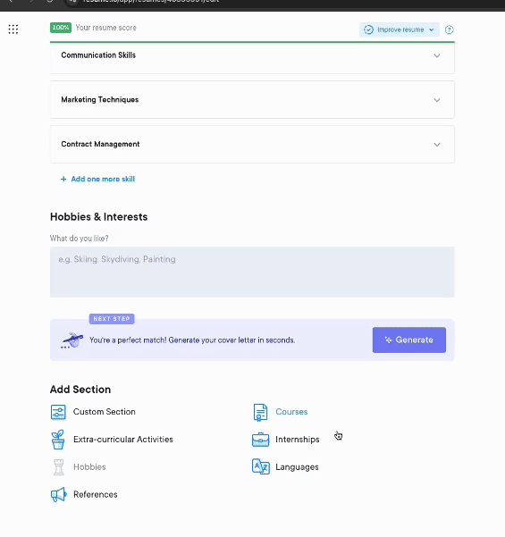
8. Resume Screening
NLP
Resume as per Job requirements
Text based generative AI tools
Search Engines
Virtual Assistants
Translation Services
Sentiment Analysis
Email Filters
Content Recommendation
Resume Screening
Content Summarization

Slide 16
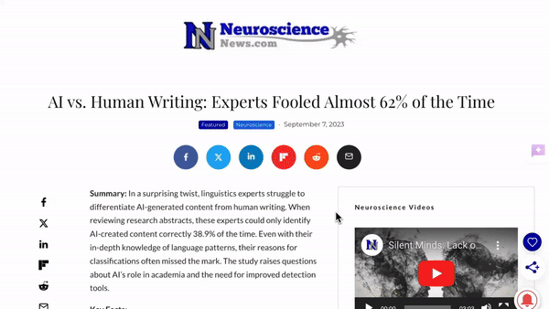
9. Content Categorization
NLP
News Article &
Academic papers
Text based generative AI tools
Search Engines
Virtual Assistants
Translation Services
Sentiment Analysis
Email Filters
Content Recommendation
Resume Screening
Content Summarization

